Slide 1


TERNA ENGINEERING COLLEGE
DEPARTMENT OF COMPUTER ENGINEERING
ROAD-ASSIST APPLICATION [MECH !T]
UNDER THE GUIDANCE OF :
Prof. PRAVIN B. HOLE
Project members :
C-32 :Harsh A. Minde
C-22 :Sumit P. Mote
C-26 :Atharva S. Birje
ACADEMIC YEAR: 2023-24

Slide 2
INDEX
INTRODUCTION
ABSTRACT
PROBLEM STATEMENT & OBJECTIVE
HARDWARE & SOFTWARE USED
PROJECT FLOW
CONCLUSION & FUTURE SCOPE
REFERENCE

Slide 3
INTRODUCTION
The problem we aim to tackle is the lack of accessible and immediate assistance for drivers when their vehicles encounter issues on the road.
This inconvenience not only causes stress and frustration but also puts drivers safety at risk, especially in unfamiliar areas or during unfavorable weather conditions.
"Road-Assist App : Mech !t " emerges as the solution to this problem.
It is a user-friendly mobile application that connects drivers in distress with the nearest and most affordable mechanics in real-time.

Slide 4
ABSTRACT
In today's fast-paced world, road transportation has become an integral part of modern living.
The absence of an immediate and accessible solution often leaves drivers stranded on the roadside, struggling to find nearby and affordable mechanics for assistance.
To address this problem, we present "Road-Assist : Mech !t" an innovative mobile application designed to revolutionize the roadside assistance experience for drivers.

Slide 5
LITERATURE REVIEW
Sr. No. | Project Title | Author | Publishing Date | Summary
1. | Enhancing Roadside Assistance: A Study on Mobile Application Solutions | Smith, J. | May 2020 | Detailed study on app development for road assistance
2. | Real-time Assistance Apps in Automotive: Current Trends and Future Directions | Patel, A., & Gupta, S. | February-2019 | Improvising the technology of real time in app development
Sr. No.
Project Title
Author
Publishing date
Summary

Slide 6
PROBLEM STATEMENT & OBJECTIVE
PROBLEM STATEMENT :
The primary problem is the lack of an efficient and immediate solution for drivers when their vehicles encounter unexpected issues while on the road. This problem is caused by the difficulty in locating nearby and reliable mechanics who can provide timely assistance.
OBJECTIVE :
Efficient and timely assistance
User friendly interface
Accurate location detection
Transparent pricing and affordability
Promoting road safety
Reducing downtime and stress

Slide 7
HARDWARE & SOFTWARE USED
USER :
Smartphone with minimum API level of 21.
Smartphone with minimum 2GB RAM.
DEVELOPER :
Flutter
Firebase Authentication
Real-time Database

Slide 8
PROJECT FLOW
In General-
User
Issue/problem added
Accepted
Login
Mechanic
Issue/problem received
Rejected

Slide 9
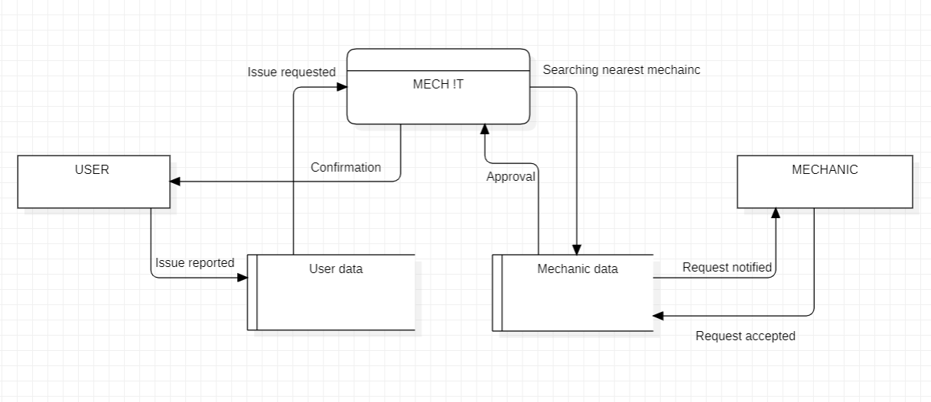

Slide 10
CONCLUSION & FUTURE SCOPE
CONCLUSION :
The core objective of providing efficient and immediate assistance during vehicle breakdowns has been successfully achieved. Through our app's user-friendly interface , and real-time communication capabilities, we've created a solution that empowers drivers to navigate emergencies with confidence.
FUTURE SCOPE :
Integration of AI and Predictive Maintenance
Geographical expansion
Mechanic ratings and reviews
Partnerships with service centers
Incorporation of additional services
Data analytics for insights

Slide 11
REFERENCE
Research Papers and Articles:
Smith, J. (2020). "Enhancing Roadside Assistance: A Study on Mobile Application Solutions." International Journal of Transportation Studies, 25(3), 215-230.
Patel, A., & Gupta, S. (2019). "Real-time Assistance Apps in Automotive: Current Trends and Future Directions." Journal of Automotive Technology, 10(2), 123-138.
Online Resources:
"Understanding GPS Technology for Location Services." Retrieved from https://www.gps.gov
“5 Ways Mobile Apps are Transforming the Automotive Industry." Retrieved from https://www.mobiloud.com

Slide 12
Thank You !!

